Slide 1


Department of Computer Science and Engineering
FAULT DETECTION SYSTEM IN STREET LIGHTS
G Anirudh
210701028
Mohneesh P 210701502

Slide 2
Abstract
The goal of the Fault Detection System in Street Light project is to create a smart street lighting system that can independently track and report on the state of streetlights’ operation. To detect and evaluate street light operation, the system combines nRF24L01 wireless communication modules, phototransistors, and Arduino Nano microcontrollers. Two phototransistors are part of the lamp module; one is used to measure the amount of ambient light and the other to track the output of the streetlight. The system determines if it is dark and, if so, examines the state of the streetlight based on the ambient light data. The state of the streetlight—whether it is bright, dull, or functioning properly—is wirelessly communicated to a central hub module. The status messages are received by the central hub module, which is outfitted with an additional Arduino Nano and a nRF24L01 module. It then displays the messages for further action. By quickly detecting malfunctioning streetlights, this real-time monitoring system improves maintenance efficiency and guarantees dependable and constant street illumination. The suggested approach offers a workable alternative for managing urban infrastructure and is both affordable and scalable.

Slide 3
Existing System
The existing system for street light maintenance primarily relies on manual inspections and public reporting. Maintenance crews are tasked with periodically checking the functionality of each streetlight, a process that is both time-consuming and labor-intensive. These inspections typically occur at set intervals, such as monthly or quarterly, regardless of whether any issues have been reported or detected, leading to inefficiencies and the potential for prolonged periods of malfunctioning lights. When a streetlight fails between inspection periods, it may remain inoperative for an extended time until the next scheduled inspection or until a public report is made.
This reactive maintenance approach leads to several significant drawbacks. There can be substantial delays between the occurrence of an issue and its detection and repair, resulting in extended periods during which streets are inadequately lit. This poses safety hazards, increases the risk of accidents, and diminishes the quality of life for residents. Additionally, the reliance on fixed operation schedules, where streetlights are turned on at dusk and off at dawn, does not account for varying ambient light conditions caused by weather changes or seasonal variations.

Slide 4
Proposed System
The proposed Problem Detection System in Street Lights offers a proactive, intelligent solution using IoT technology. Each streetlight is equipped with phototransistors to monitor light output and ambient light levels, connected to an Arduino microcontroller that processes the data. Wireless communication modules (nRF24L01) transmit this information to a central hub module, which aggregates and presents it to maintenance staff in real-time. This system can instantly detect and report issues, allowing for prompt repairs and reducing the need for manual inspections. By continuously monitoring each streetlight, the system enables proactive maintenance, ensuring that problems are addressed before being reported by the public. Moreover, the system can optimize energy usage by adjusting streetlight operation based on real-time ambient light conditions, turning lights on or off as needed to enhance energy efficiency. This approach not only improves public safety and the quality of urban lighting but also reduces operational costs and enhances the overall efficiency of street light maintenance operations.

Slide 5
List of Modules
Lamp Module
Wireless communication
Hub Module
Fault detection And Monitoring
Continuous Monitoring

Slide 6
Functional Description for each modules
Lamp Module Operation:
• The lamp module consists of hardware components such as an Arduino Nano, phototransistors, LEDs, potentiometers, and a power supply.
• Phototransistors detect ambient light and street light status. One monitors ambient light levels, while the other detects the streetlight’s output.
• The Arduino Nano processes data from phototransistors, determining if the streetlight is functioning properly, dim, or off.
• Based on the assessment, LEDs on the lamp module indicate the status: on (bright), dim, or off.
Wireless Communication:
• Using nRF24L01 wireless communication modules, the lamp module transmits status information wirelessly to the central hub module.
• The communication protocol ensures reliable transmission of data between lamp and hub modules.
Hub Module Reception:
• The hub module receives status messages from multiple lamp modules within its range.
• An Arduino Nano and an nRF24L01 module are integrated into the hub module to facilitate data reception.

Slide 7
Functional Description for each modules
Status Display:
• The hub module interprets received data and displays the status of each streetlight 12 on a central monitoring system.
• Maintenance personnel can monitor the system's dashboard, which shows the real-time status of all streetlights.
Fault Detection and Reporting:
• If the system detects that a streetlight is not functioning correctly (dim or off), it immediately relays this information to the hub module.
• The central monitoring system highlights the faulty streetlight, allowing maintenance personnel to address the issue promptly.
Continuous Monitoring:
• The system continuously monitors ambient light and street light statuses, ensuring timely detection and reporting of faults.
• Maintenance personnel can access historical data and performance metrics to optimize maintenance schedules and improve overall system reliability.

Slide 8
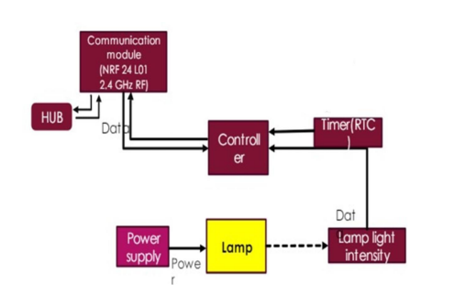
System Architecture

Slide 9
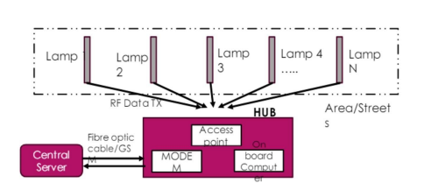
System Architecture

Slide 10
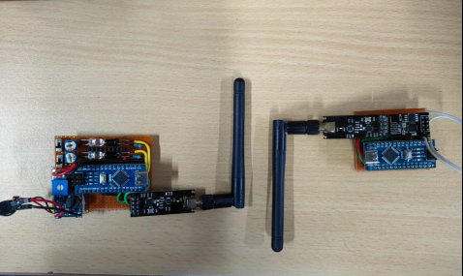
Output

Slide 11
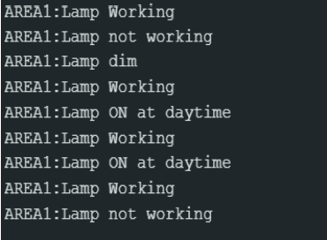
Output

Slide 12
Conclusion
In conclusion, the Fault Detection System in Street Light project represents a significant step forward in enhancing street lighting maintenance and improving urban infrastructure management. Through rigorous evaluation and discussion, the project has demonstrated the effectiveness of the developed system in promptly detecting and reporting street light faults, thereby reducing downtime and enhancing public safety in urban areas. While the project has shown promising results, challenges and limitations encountered underscore the need for continuous improvement and innovation in smart infrastructure solutions. Addressing these challenges and exploring opportunities for enhancement will be crucial in maximizing the system's impact and scalability in diverse urban environments. Overall, the Fault Detection System in Street Light project holds immense potential in advancing the sustainability, efficiency, and resilience of urban infrastructure. By leveraging cutting-edge technologies and innovative approaches, the project contributes to creating smarter, safer, and more livable cities for communities around the world. As urbanization continues to accelerate, solutions like this will play a pivotal role in shaping the cities of tomorrow.

Slide 13
References
[1] Smith, J., et al. (2021). "Internet of Things (IoT) Enabled Smart Street Lighting: A Systematic Review." Journal of Smart Cities, 5(2), 123-136.
[2] Johnson, A., & Lee, C. (2020). "Fault Detection in Electrical Systems: A Review." IEEE Transactions on Power Systems, 35(6), 4892-4903.
[3] Chen, L., et al. (2019). "Wireless Sensor Networks for Urban Infrastructure Monitoring: A Review." Sensors, 19(8), 1798.
[4] Wang, X., & Zhang, Y. (2018). "Energy-Efficient Lighting Technologies: A Review." Energy Efficiency, 11(6), 1345-1362.
[5] Gupta, S., et al. (2020). "Real-Time Monitoring Systems for Infrastructure Maintenance: A Review." Journal of Infrastructure Systems, 26(3), 04020036.
[6] Brown, D., & Davis, R. (2019). "Smart City Development and Sustainability: A Review." Sustainability, 11(10), 2833.

Slide 14
Thank You

